Slide 1
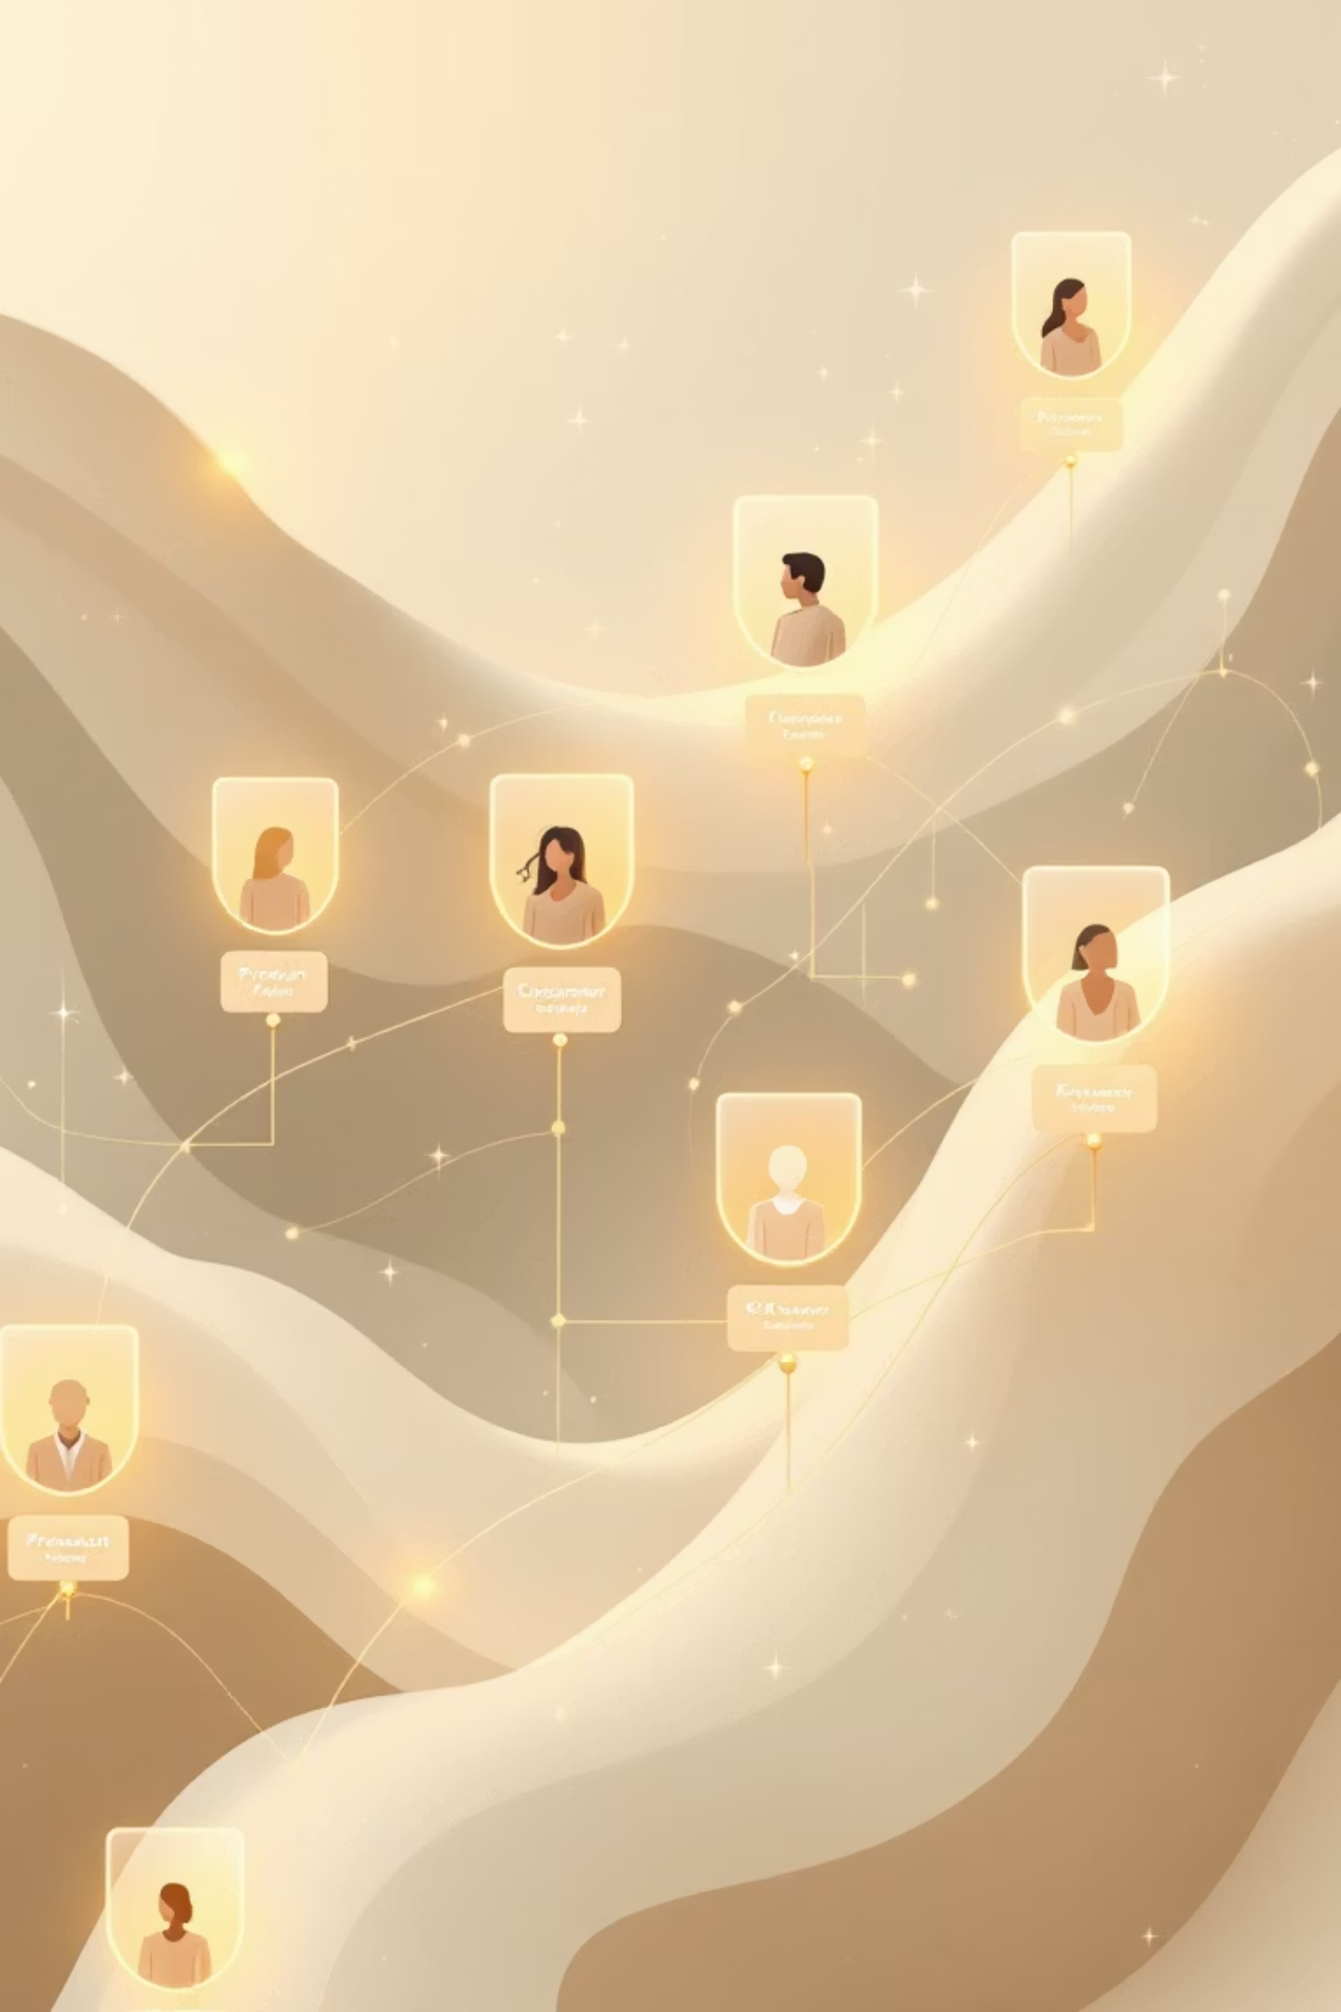
Customer Shopping Behavior Analysis
Uncovering insights from transactional data to guide strategic business decisions.

Slide 2

Project Overview
1
2
3
Analyze Behavior
Uncover Insights
Guide Decisions
3,900 purchases across categories.
Spending patterns, segments, preferences.
Optimize business strategy.

Slide 3

Dataset Summary
Rows: 3,900
Key Features:
Columns: 18
Customer demographics
Missing Data: 37 values in Review Rating.
Purchase details
Shopping behavior

Slide 4

Exploratory Data Analysis (Python)
01
Data Loading & Exploration
Imported with pandas, checked structure.
02
Missing Data Handling
Imputed Review Rating with median.
03
Feature Engineering
Created age_group, purchase_frequency_days.
04
Database Integration
Loaded cleaned data to PostgreSQL.

Slide 5
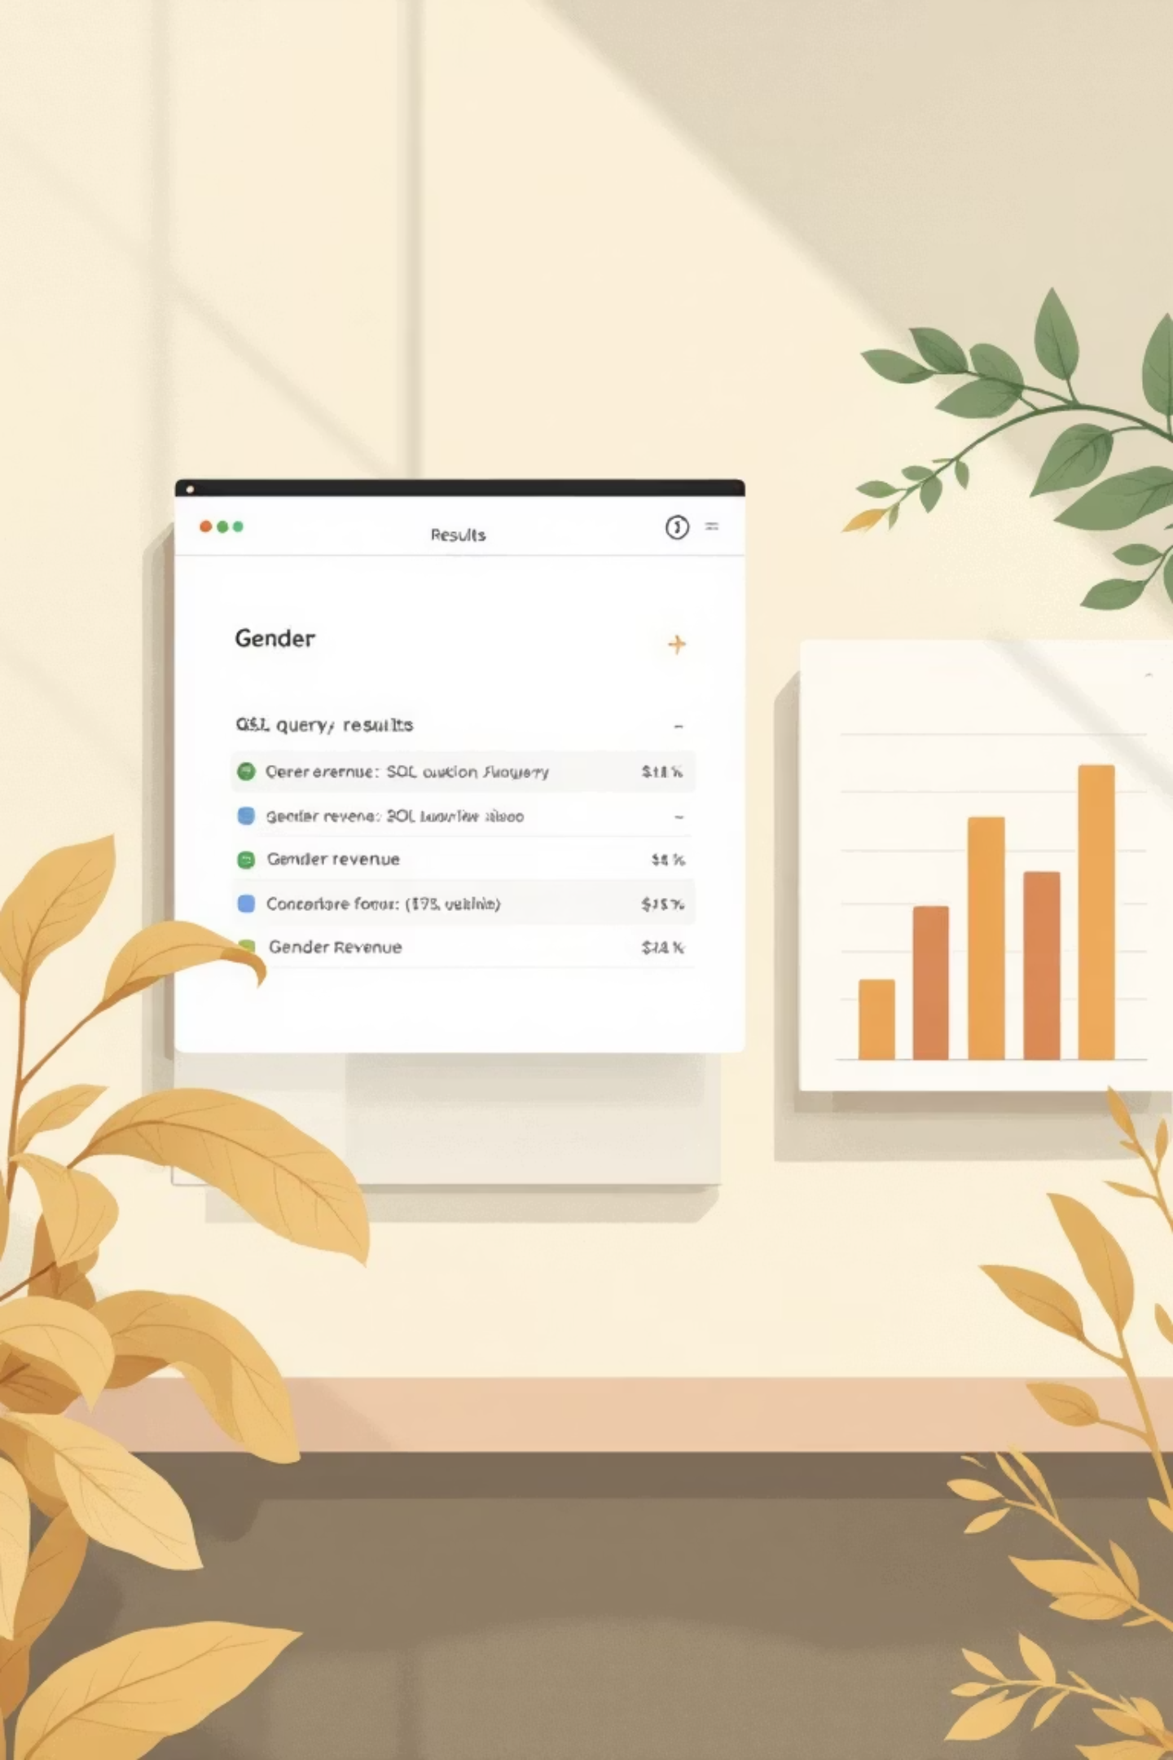
Data Analysis (SQL)
Revenue by Gender
High-Spending Discount Users
Male: $157,890, Female: $75,191
839 customers above average spend.
Top 5 Products by Rating
Gloves, Sandals, Boots, Hat, Skirt.

Slide 6


SQL Analysis: Shipping & Subscriptions
Shipping Type Comparison
Subscribers vs. Non-Subscribers
Standard: $58.46 avg. purchase
Subscribers: 1053 customers, $62,645 revenue
Express: $60.48 avg. purchase
Non-Subscribers: 2847 customers, $170,436 revenue

Slide 7
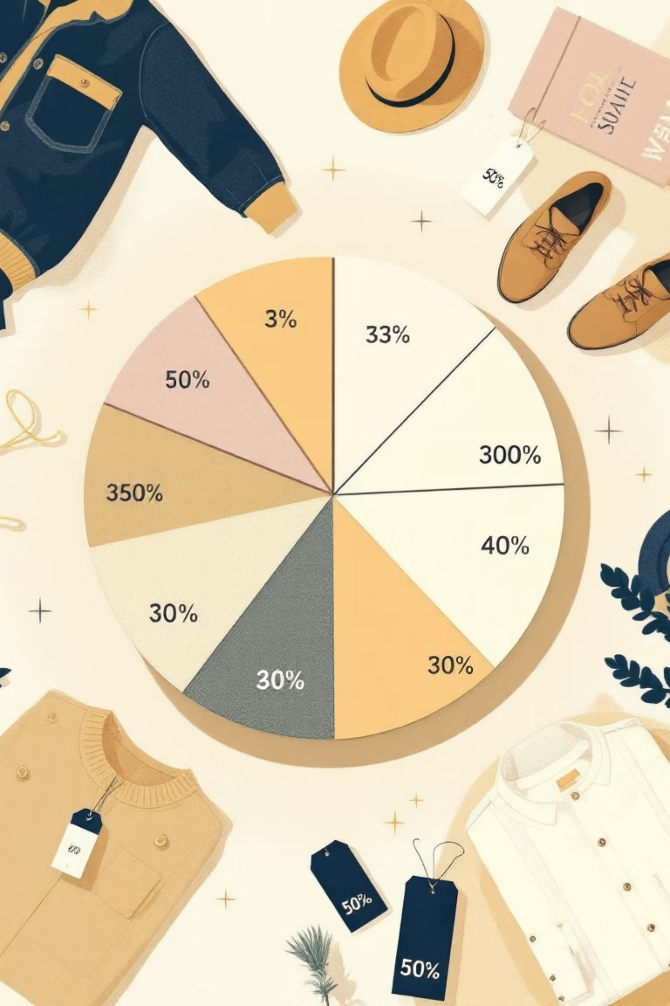
SQL Analysis: Products & Segments
Discount-Dependent Products
Hat (50%), Sneakers (49.66%), Coat (49.07%), Sweater (48.17%), Pants (47.37%).
Customer Segmentation
Loyal (3116), Returning (701), New (83).

Slide 8


SQL Analysis: Top Products & Age Groups
Top Products per Category
Revenue by Age Group
Accessories: Jewelry, Sunglasses, Belt
Young Adult: $62,143
Clothing: Blouse, Pants, Shirt
Middle-aged: $59,197
Footwear: Sandals, Shoes, Sneakers
Adult: $55,978
Outerwear: Jacket, Coat
Senior: $55,763

Slide 9
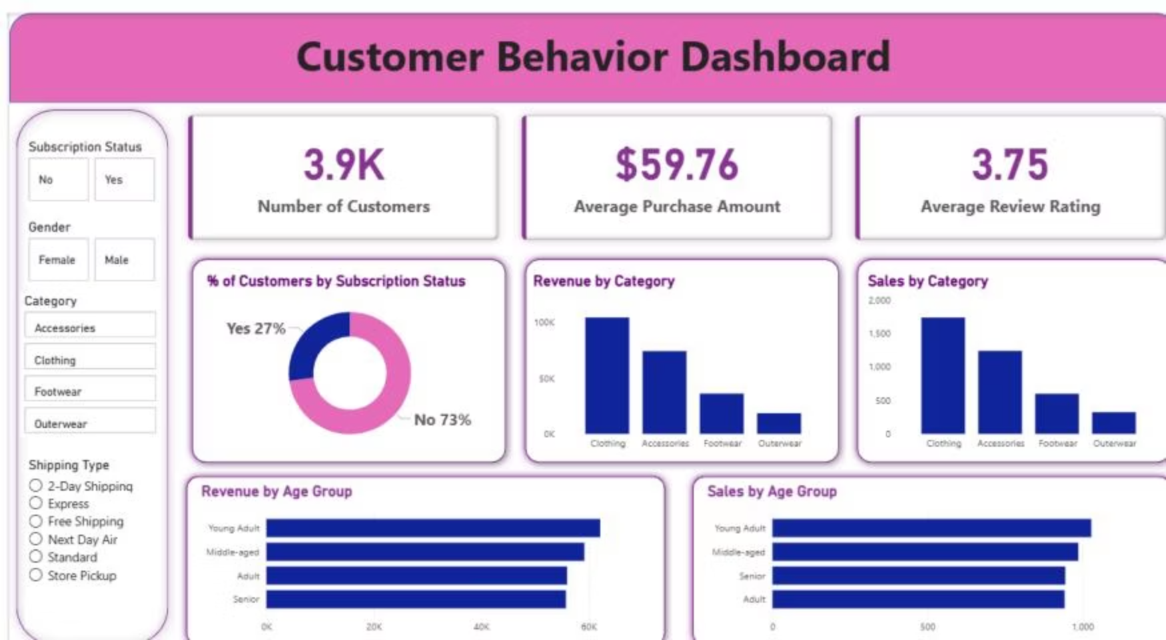

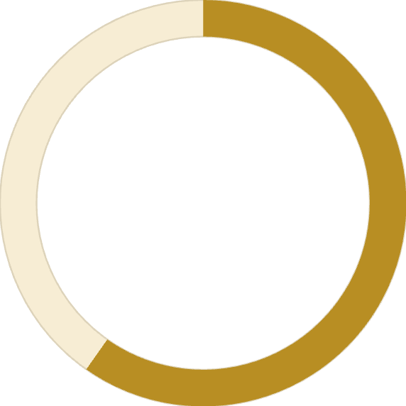

Power BI Dashboard
Interactive dashboard for visual insights.
3.9K
$59.76
3.75
Customers
Avg. Purchase
Avg. Review

Slide 10





Business Recommendations
Boost Subscriptions
Promote exclusive benefits.
Customer Loyalty Programs
Reward repeat buyers.
Review Discount Policy
Balance sales with margins.
Targeted Marketing
Focus on high-revenue groups.

